Slide 1
Adv. Biopharmaceutics
Dr. Mohammed Sabbar
College Of Pharmacy - Basrah
3rd Oct. 2018
http://bit.do/ex2aD

Slide 3
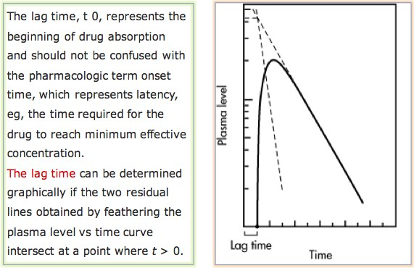

Slide 5
PRACTICE PROBLEM
Drug concentrations in the blood at various times are listed in . Assuming the drug follows a one-compartment model, find the k _{a}, and compare it with the k _{a} value obtained by the method of residuals.

Slide 6
ESTIMATION OF K_{A} FROM URINARY DATA
On you ####

Slide 7
Thank you

